Slide 1
BUSINESS
CHAMPION
AWARDS
CAROL FEBRY
Local Community Lead
KAREN WILSON
FoodLoose Community Ally

Slide 2
TODAY’S
PRESENTATION
• Register for Plastic-Free Champion status
• Items to remove from your business
• Understand reducing single-use plastics
• Be ready to register for a Bronze Award

Slide 3
BECOMING A
PLASTIC-FREE
CHAMPION
Start your business registration at:
plasticfree.org.uk/register-your-business

Slide 4
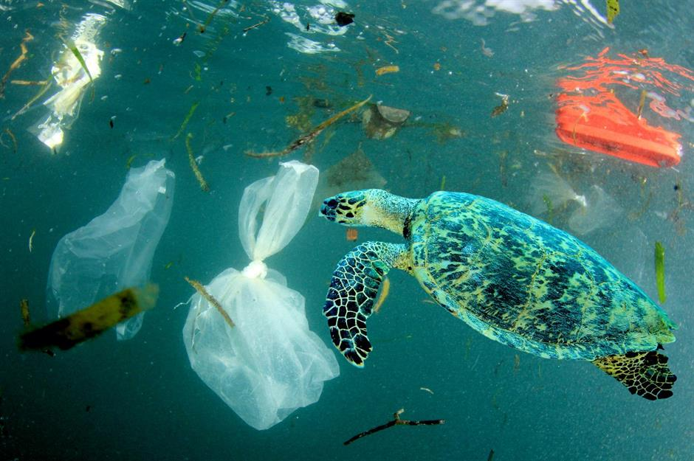
Plastics in
My business
Emissions
‘Petroleum-based’ contributes to climate change
Pollution
of land and water environments. 88% of the
sea surface is polluted by plastic waste
Animals
Death & injury from ingestion or entanglement
1M seabirds and 100,000 animals die each year
Microplastics
In air, soil and water. Harmful effects in the
food chain and throughout the environment
5.25 trillion macro and microplastics are in
the open ocean

Slide 5
How to be a plastic-free Business champion

Slide 6
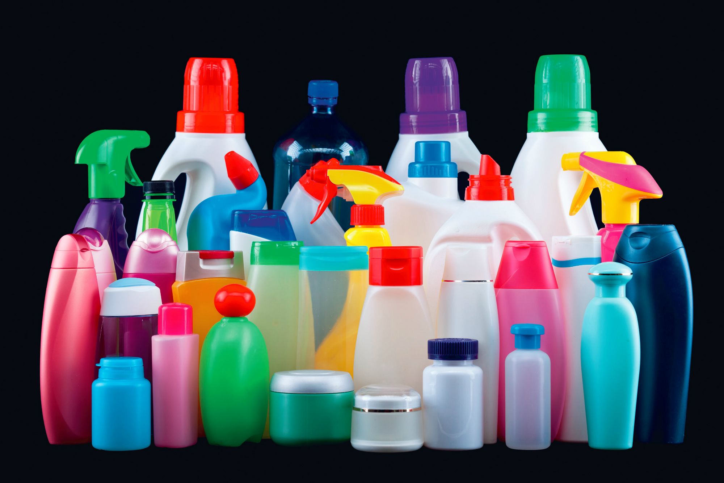
Table discussion
What single-use plastics do you
currently use in your business?
Now choose at least 3 items you are able to
swap or remove from your business
The substitute
What is my plan to achieve this?

Slide 7
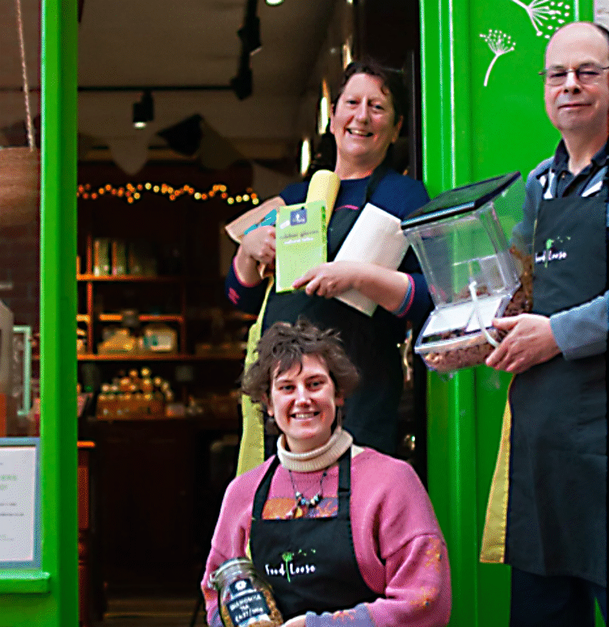
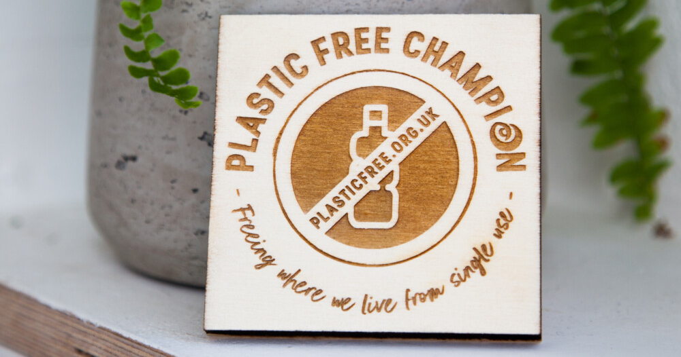
Plastic-free
Champion,You’re
On your way!
You have registered for access to the
SAS Plastic Free Champion portal
You have considered the plastic you use
within your business
You have identified your first three single-use
plastic items to remove or swap from your
business to enable you to apply for
a Bronze award

Slide 8
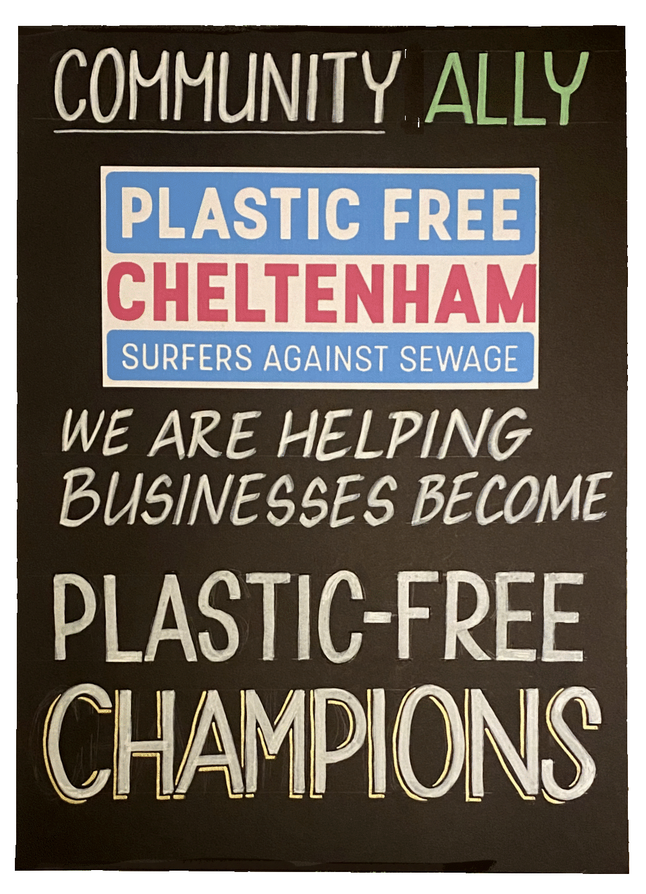
A local Plastic-free Champion business...
FoodLoose’s Co-Manager KAREN WILSON
Cheltenham’s first Plastic-Free Community
Shop, FoodLoose, in Grosvenor Terrace,
has had its Plastic-Free Business
Champion Award now for over 4 years

Slide 9
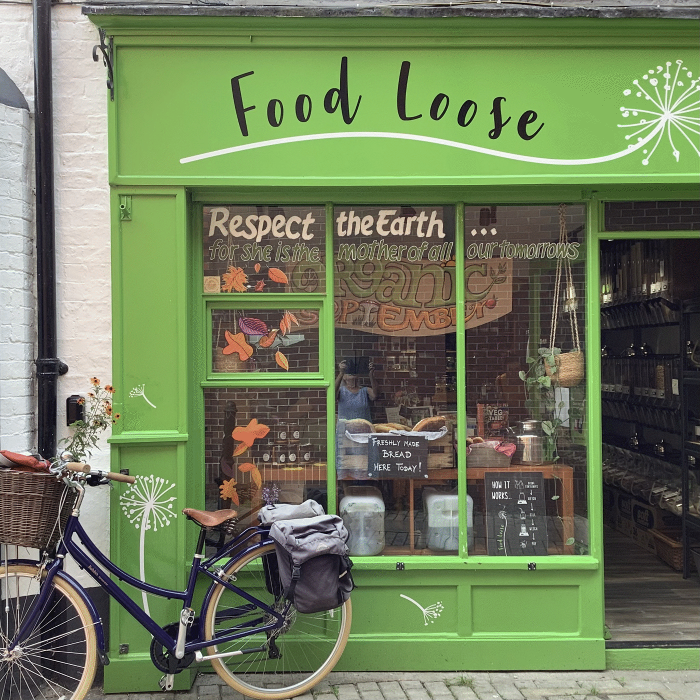
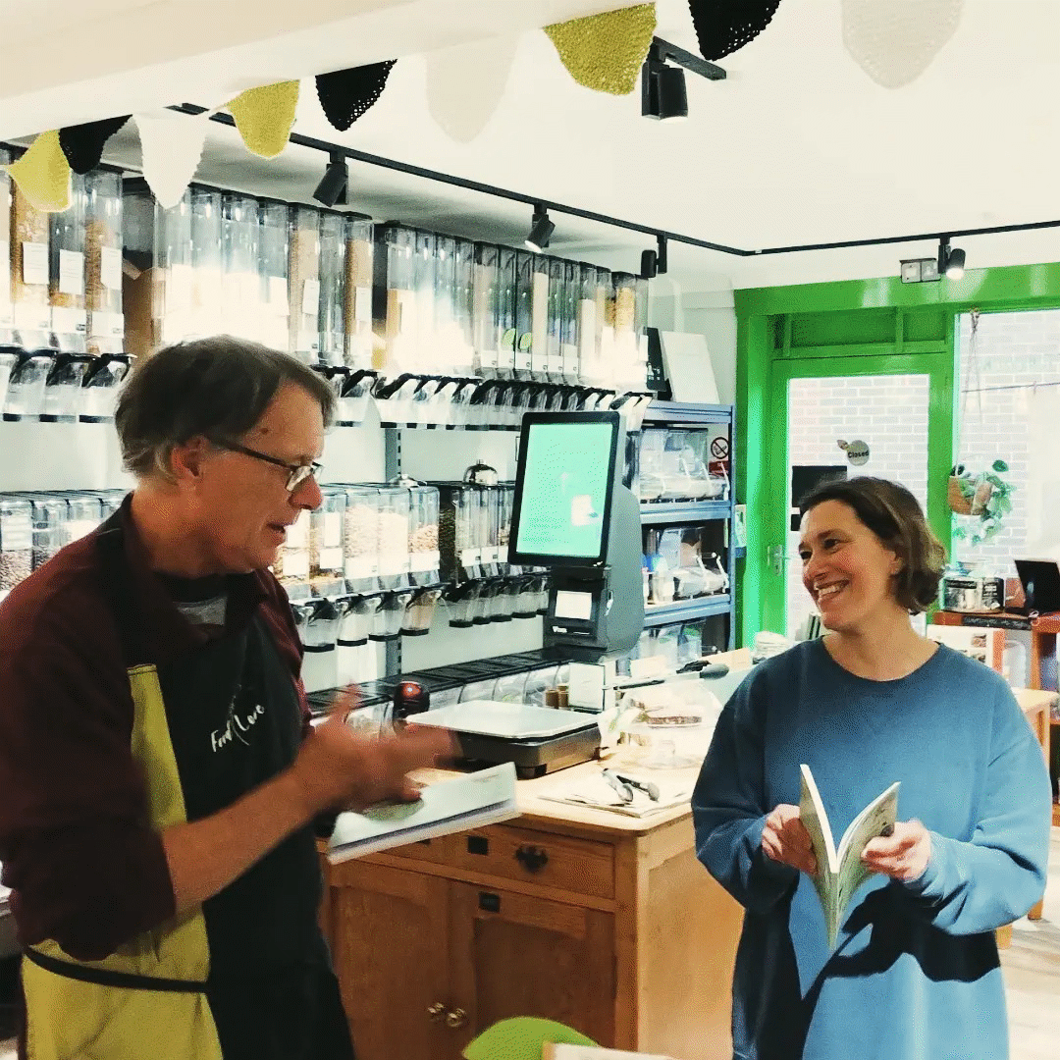
Cheltenham’s
First plastic-free shop
Started as a refill shop in 2018 by four women with a passion about reducing plastic waste
A volunteer-run, not-for-profit community shop with a few staff paid for essential duties
We offer our customers a membership to collect points for discount when you spend with us
We registered as a Community Benefit Society
with a few member-investors which enabled
us to move into our own premises at
Grosvenor Terrace

Slide 10
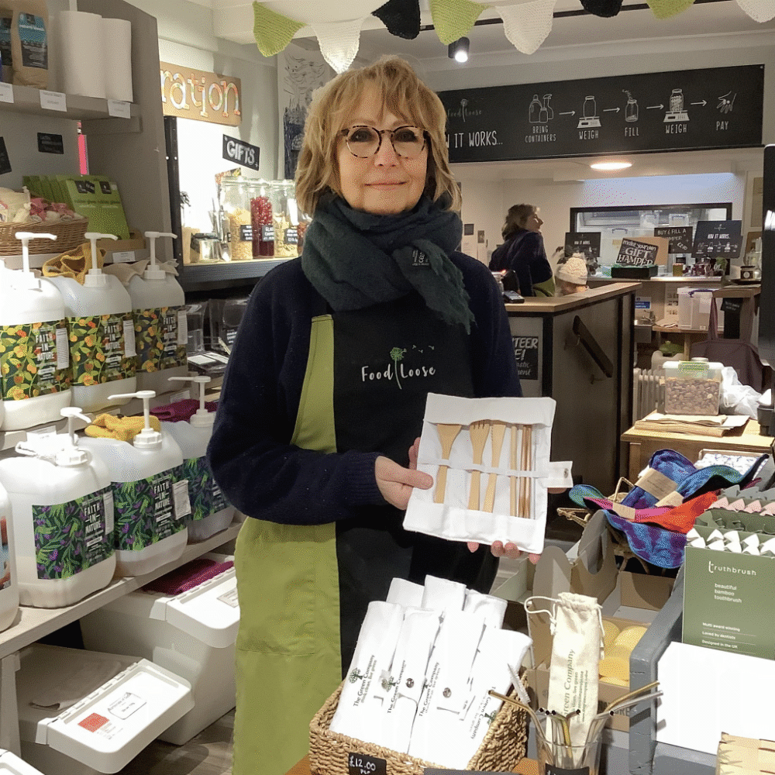
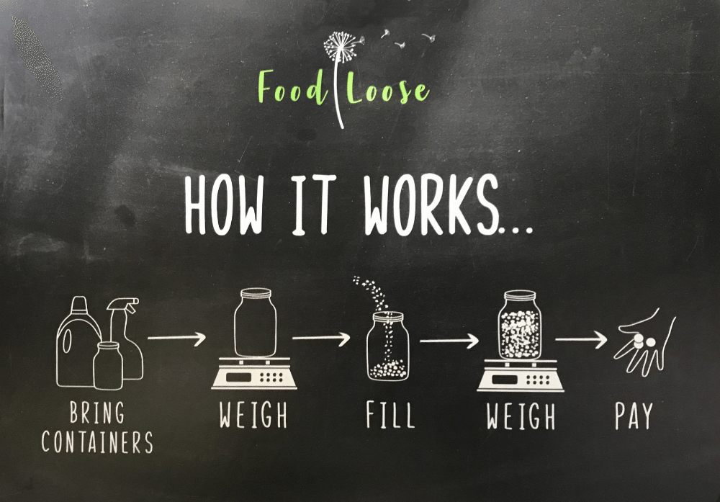
How it works...
We sell store-cupboard foods, personal and
household items where our customers bring
their own containers (which can be plastic,
glass, paper bags, cloth sacks or tins),
which they weigh on arrival

Slide 11
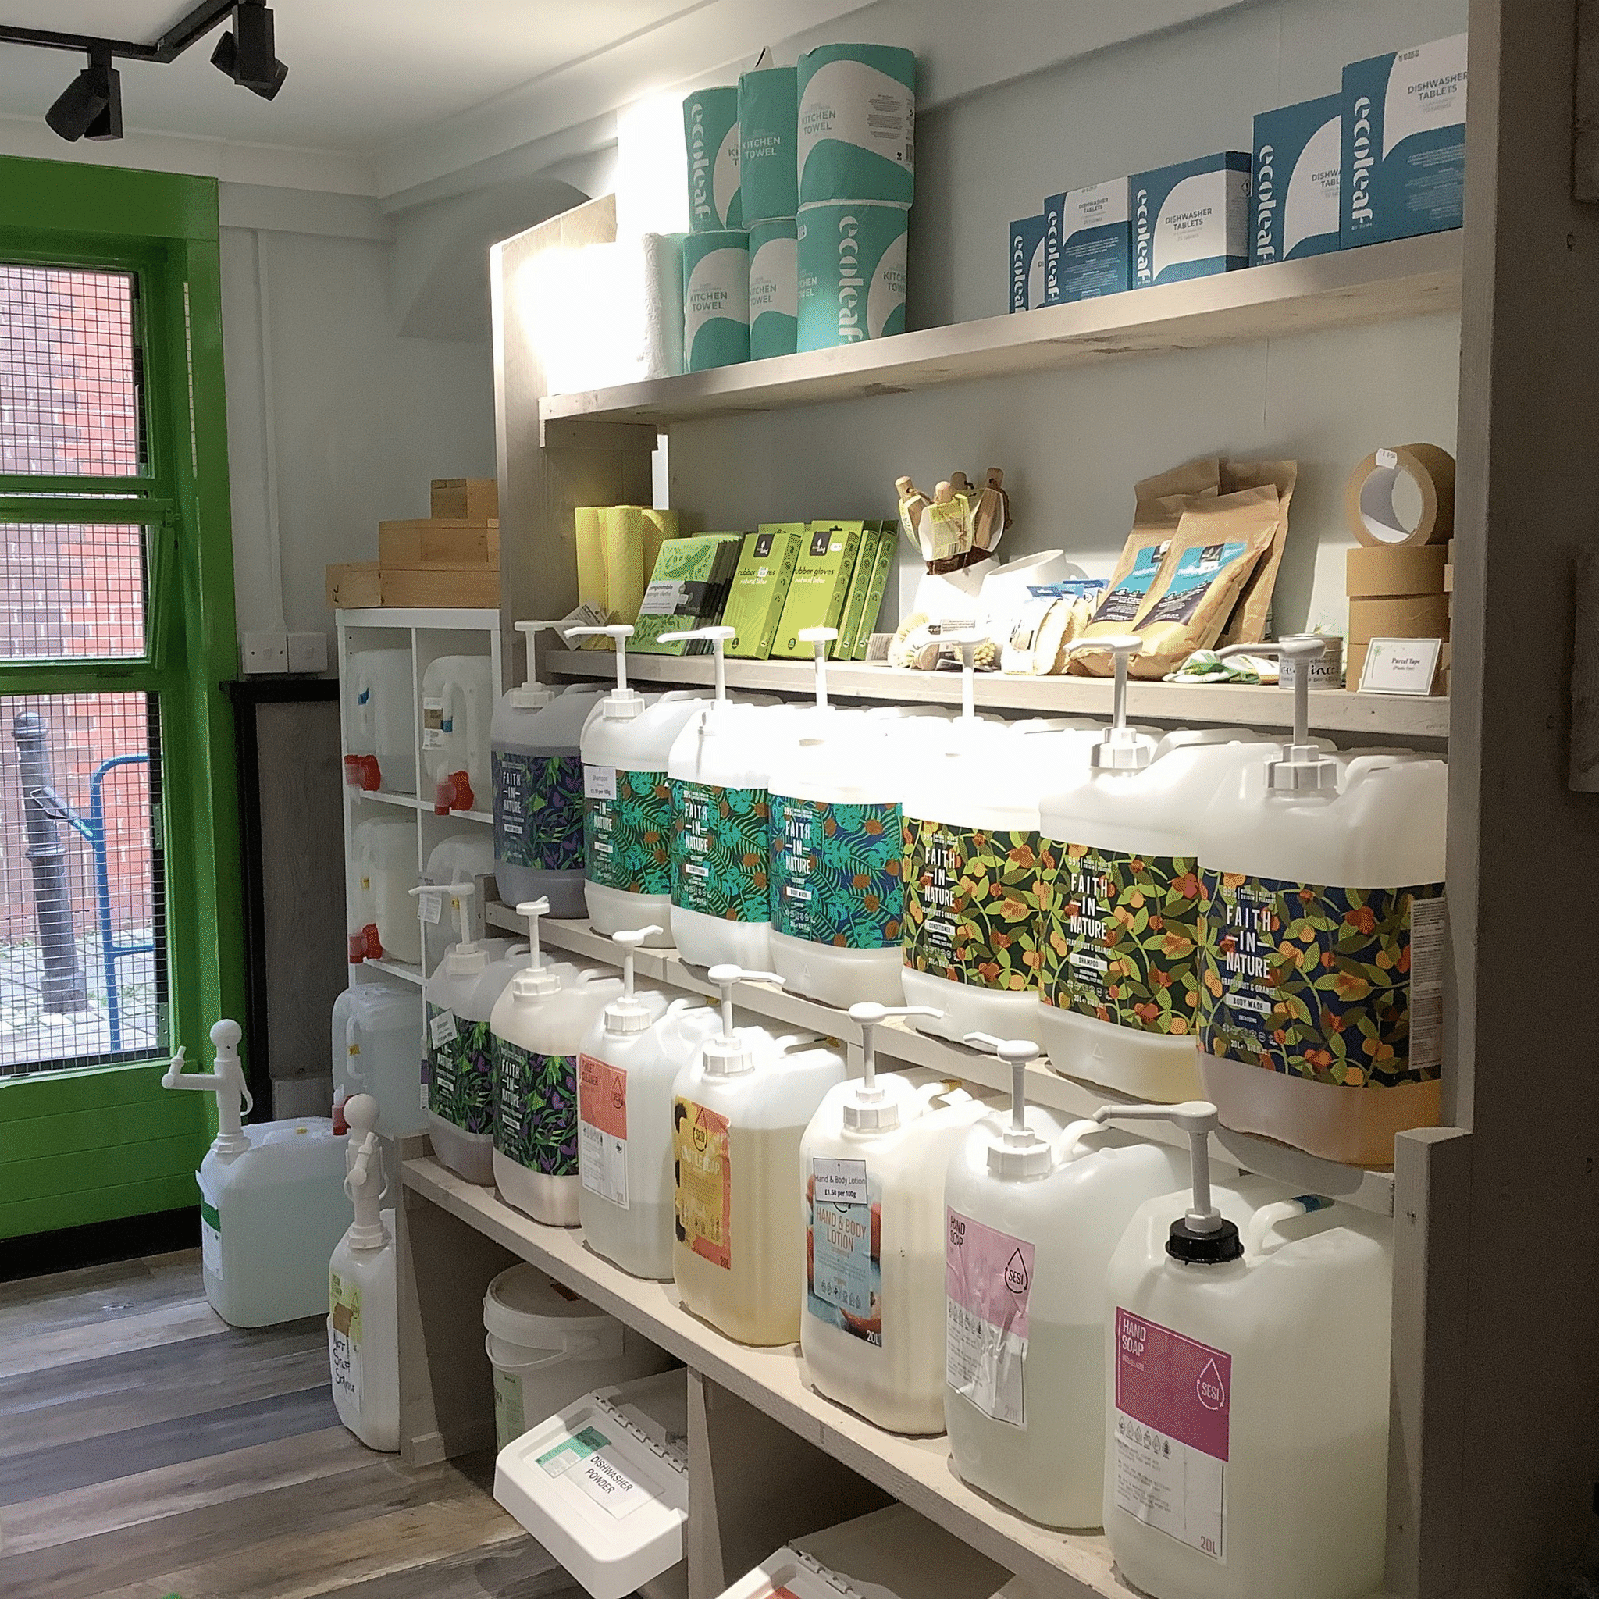
Our Closed-
loop System explained
Our products arrive in 20-litre containers from
SESI and Faith in Nature, where our customers
dispense them into their own containers
Once empty, these containers are rinsed and
returned to our suppliers where they clean and
refill them for re-use
We can offer this closed-loop system to
businesses with our 5-litre containers which
can be returned and refilled for you with
cleaning and other household products

Slide 12
Our b2b
Starter packs
And brochure
Our Starter Packs can include:
Washing-up liquid
All-purpose cleaner
Toilet cleaner
Toilet roll
Kitchen roll
Rubber gloves
Washing-up pads
Kitchen sponge
Strong paper tape
… and so much more!

Slide 13
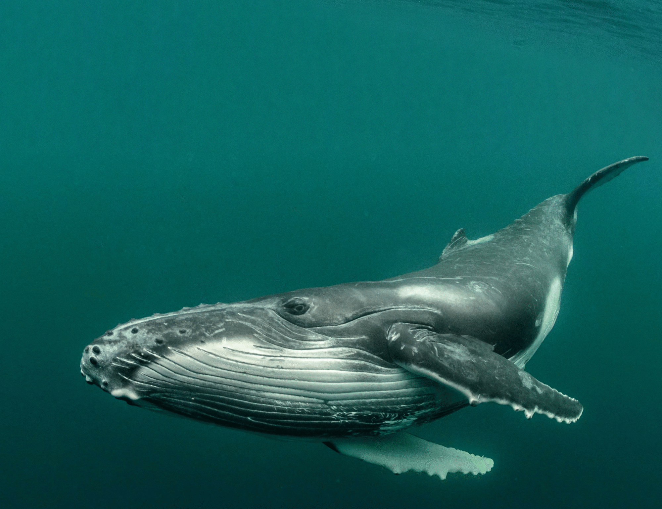
Thank you!
Together we can stop plastic waste… One piece at a time

